Slide 1
EA For SBME Department
Prepared By : Moustafa Okbelbab
Mohamed Magdy
Mohamed Morsy
Eslam Khaled
Faculty Of Engineering
Cairo University
Biomedical Engineering Department

Slide 2
Outlines
Objectives .
Project Description .
Archimate Tool .
Types of EA Layers and Extensions.
References .

Slide 3
Objectives
Everyone in the department is expected to do his/her mission effectively as these missions are dependent. So we started to make our framework to integrate between these missions easily and efficiently, create strong relations between them and demonstrate how to interact with each other professionally.

Slide 4
Project Description
The processes must be organized and managed to achieve progress, higher performance and best quality.
choose Biomedical Department to apply EA with it.
We expect our framework will assess running processes in this department to improve it in the near future by making its systems integrated, organized and managed.

Slide 5
Archimate Tool
This is simple tool to achieve our objective but under some features .
These Features are Layers and Extensions .

Slide 6
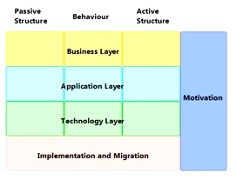
Types of EA Frame Work
1. Business layer
2. Application layer
3. Technology layer

Slide 7
Business Layer
Consist of 3 Layers :
1- Organizational ViewPoint .

Slide 8
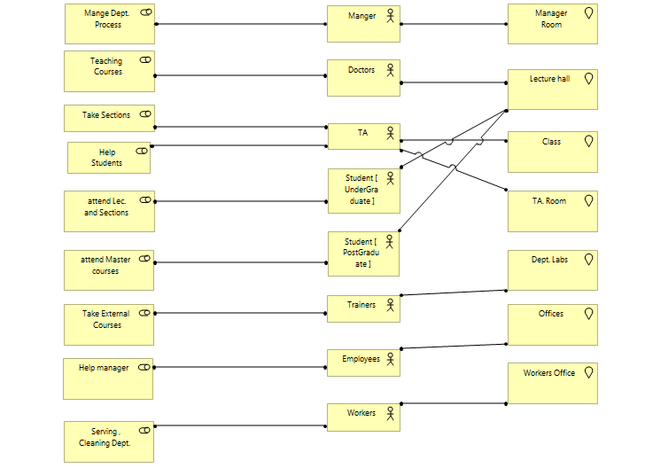
Organizational ViewPoint

Slide 9
Business Layer
Consist of 3 Layers :
2- Business Process ViewPoint .

Slide 10
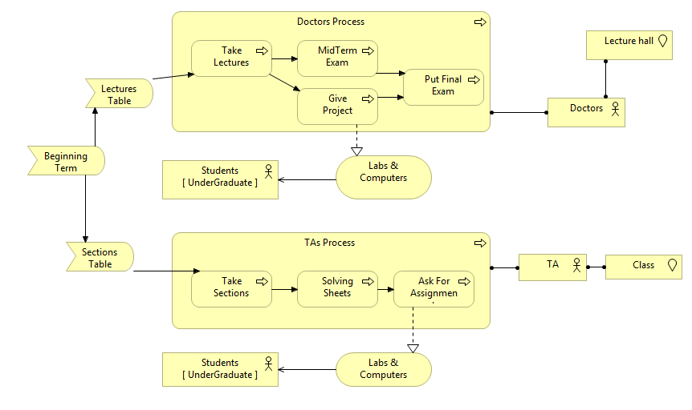
Business Process ViewPoint

Slide 11
Business Layer
Consist of 3 Layers :
3- Product ViewPoint .

Slide 12
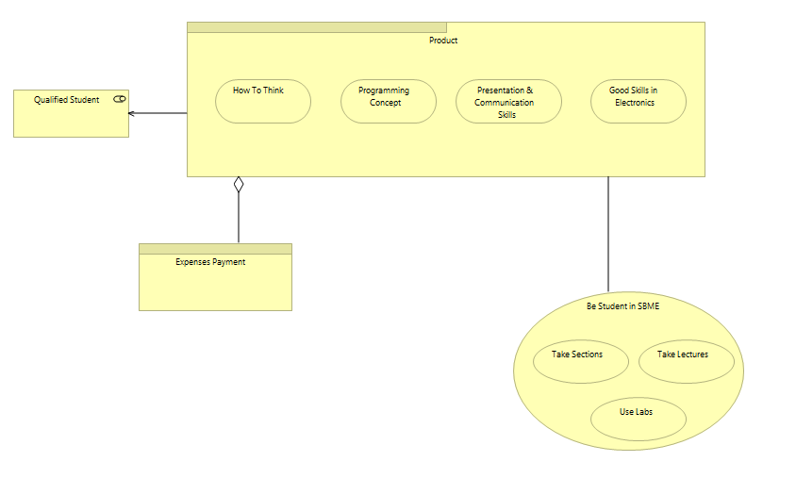
Product ViewPoint

Slide 13
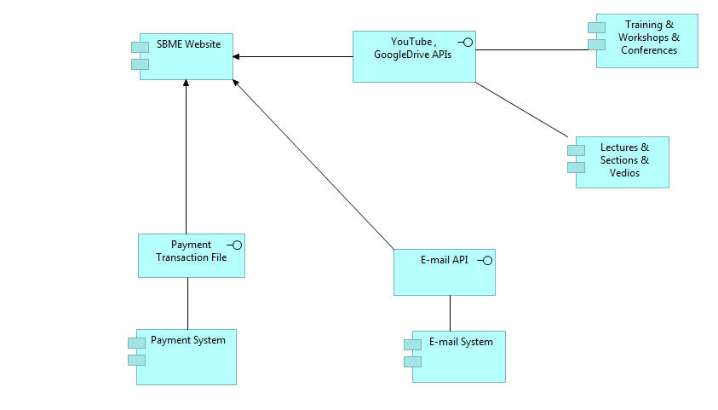
Application Layer

Slide 14
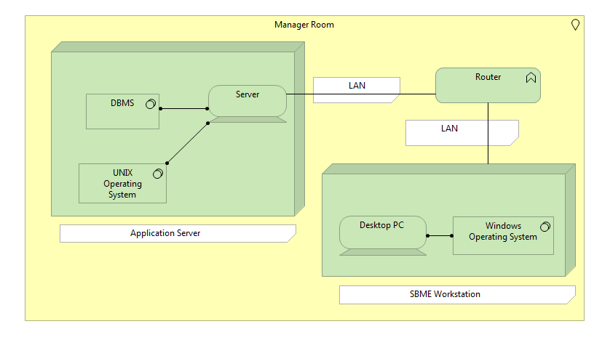
Technology Layer

Slide 15
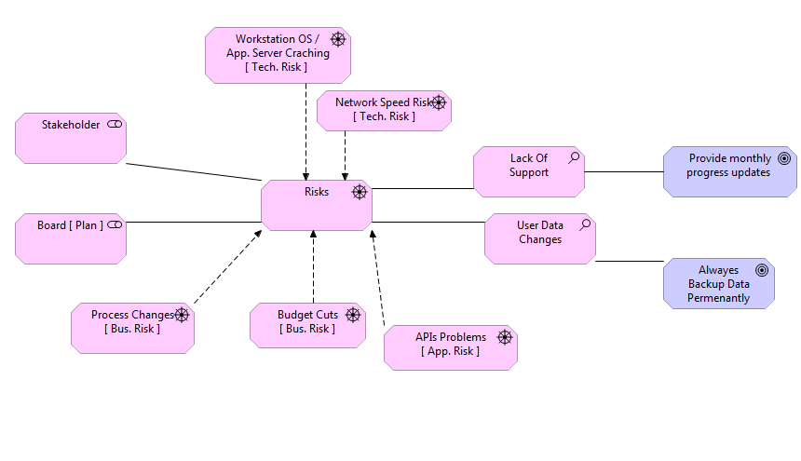
Types of Extensions.
Motivation

Slide 16
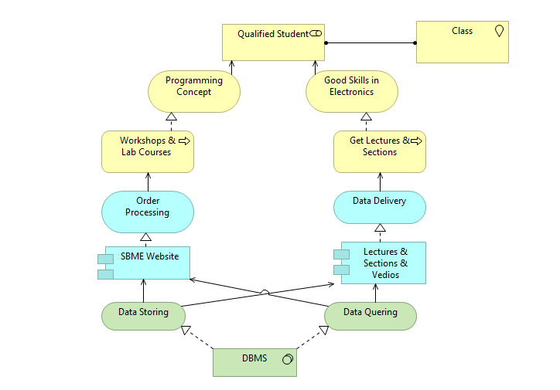
Types of Extensions.
Implementation
and Migration

Slide 17
Resources
https://drive.google.com/folderview?id=0B8aOBovXz8Fub1ZSc2hydU1zRWs&usp=sharing

Slide 18
Thanks For Your Attention

